Slide 1


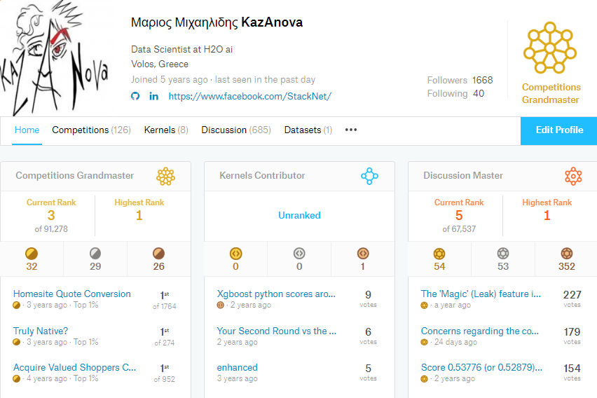
Background
Competitive data scientist at
PhD in ensemble methods
Former kaggle #1
Currently (#3)

Slide 2
What is ensemble modelling?
It means combining different machine learning models to get a better prediction.

Slide 3
Example of ensemble methods
Averaging
Weighted averaging
Bagging
Boosting
Stacking
StackNet

Slide 4
Examples of averaging
(model 1 x 0.7 + model 2 x 0.3)
(model 1 + model 2)/2

Slide 5
Stacking /Stacked Generalization
It was introduced by Wolpert in 1992. It involves:
Splitting the train set into two disjoint sets.
Train several base learners on the first part.
Make predictions with the base learners on the second (validation) part.
Using the predictions from (3) as the inputs to train a higher level learner.

Slide 6

Stacking process
Train algorithm 0 on A and make predictions for B and C and save to B1, C1
Train algorithm 1 on A and make predictions for B and C and save to B1, C1
Train algorithm 2 on A and make predictions for B and C and save to B1, C1
Consider datasets A,B,C. Target variable (y) is known for A,B
Train algorithm 3 on B1 and make predictions for C1

Slide 7

What is StackNet
Scalable Stacking on multiple levels – like a neural network

Slide 8
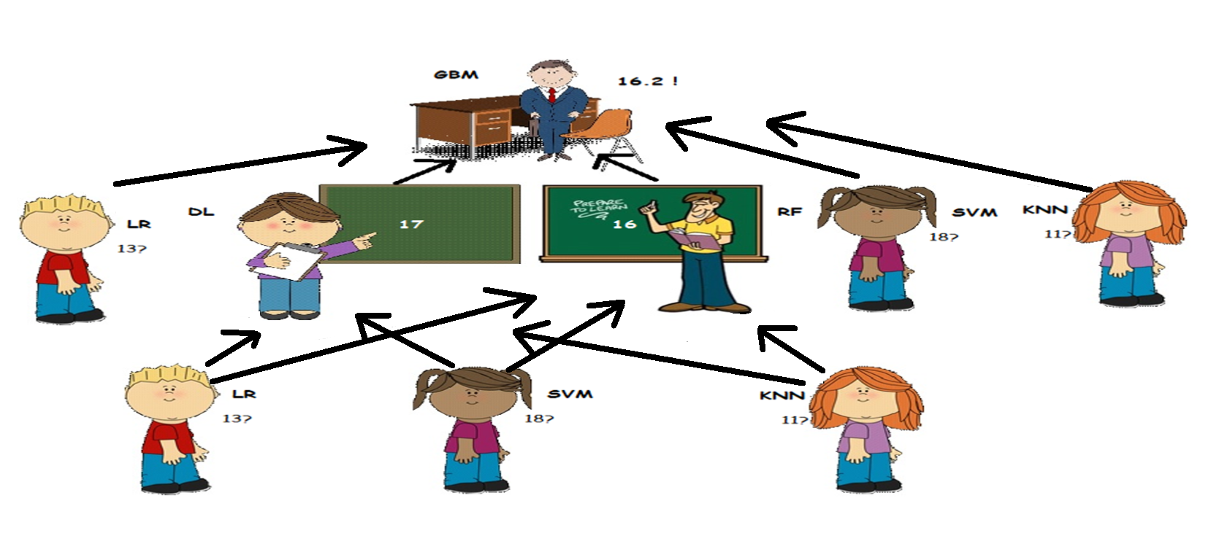

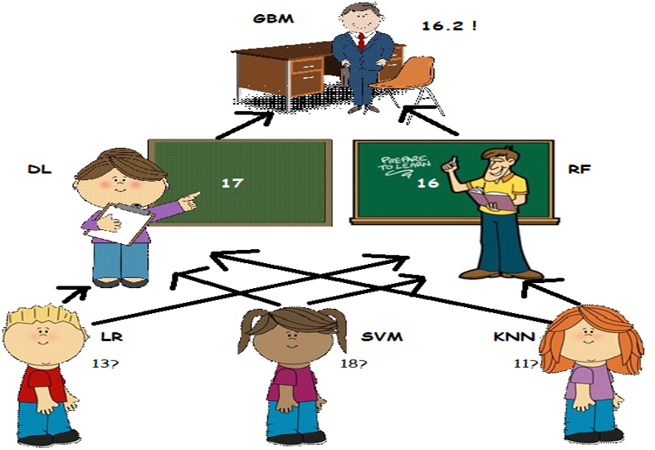
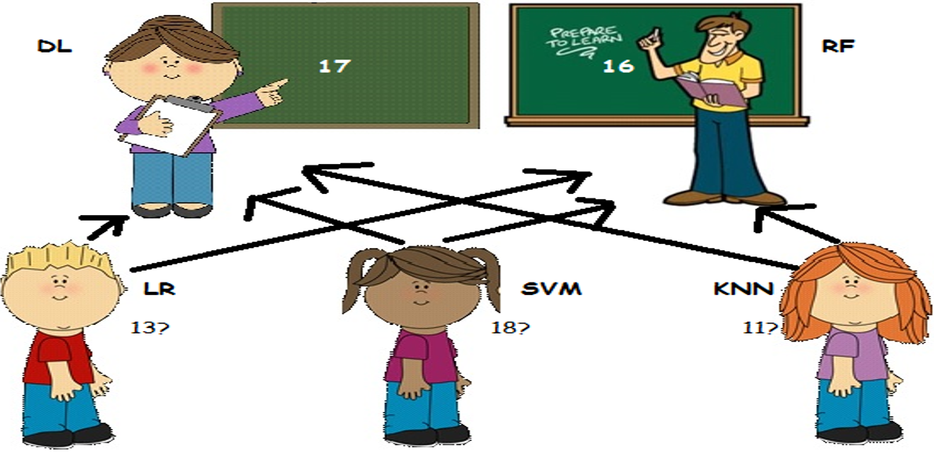
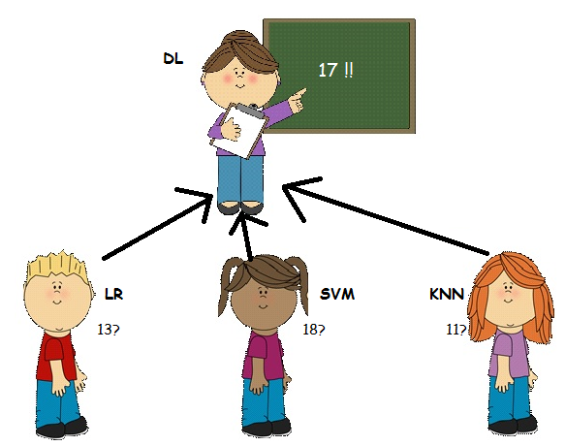
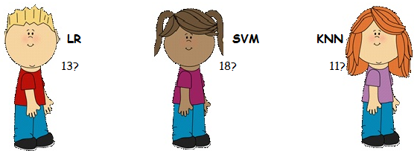

Meta modelling on multiple levels
RESTACKING
RAW DATA
14

Slide 9
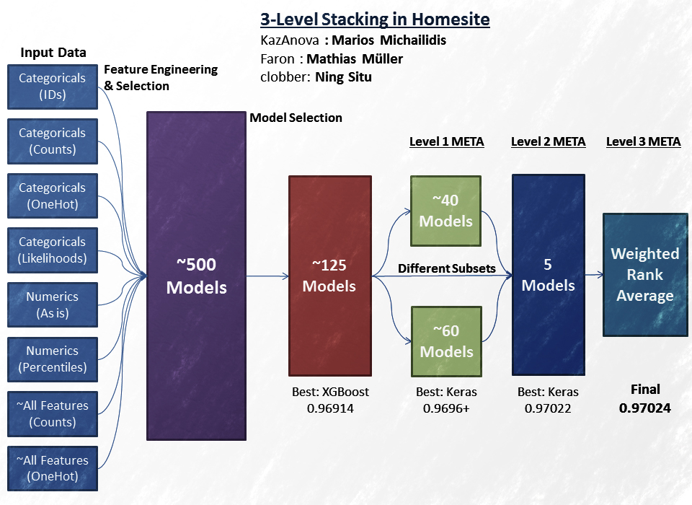
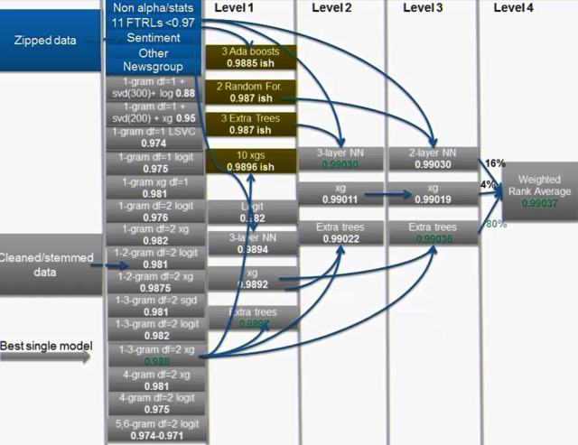
Was used to win Kaggle competitions

Slide 10
How to train
K=4
Fold : 1
Fold : 2
Fold : 3
Fold : 4
Predict
Mini train
Mini valid
Train
Training data
Train data
Valid data

Slide 11
Implementations
Java: https://github.com/kaz-Anova/StackNet
Python: https://github.com/h2oai/pystacknet

Slide 12




Java implementation - Algorithms
Linear Regression
Logistic regression
Kernel models
K nearest neighbours
GBMs
Naïve Bayes
LibFm
Multilayer Perceptron
Decision trees
Random Forests
Lightgbm

Slide 13
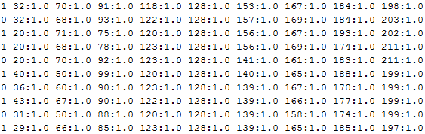
Java -Command Line parameters
Input data
Command | Explanation
sparse | True if the data to be imported are in sparse format (libsvm)
has_head | True if train_file and test_file have headers else false
model | Name of the output model file.
pred_file | Name of the output prediction file.
train_file | Name of the training file.
test_file | Name of the test file.
test_target | True if the test file has a target variable in the beginning
params | Parameter file where each line is a model.
verbose | True if we need StackNet to output its progress else false
threads | Number of models to run in parallel.
metric | Logloss, Rmse, accuracy or auc (for binary only)
stackdata | True for restacking else false
seed | Integer for randomised procedures
folds | Number of folds for re-usable kfold
Java –jar stacknet.jar
train task=classification
sparse=false
model=model.mod
pred_file=pred.csv
train_file=sample_train.csv
test_file=sample_test.csv
params=params.txt
verbose=true
threads=3
metric=logloss
Target variable
Sample Parameter’s File
LogisticRegression Type:Liblinear C:2.0 threads:1 usescale:True
GradientBoostingForestClassifier estimators:300 shrinkage:0.10 max_depth:6 max_features:0.5
RandomForestClassifier estimators:300 threads:5 max_depth:16 max_features:0.25
RandomForestClassifier estimators:1500 max_depth:7 max_features:0.2 min_leaf:1.0

Slide 14
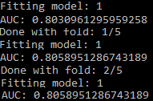
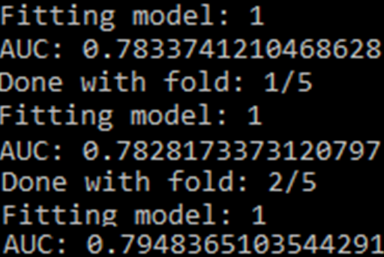
Finding good parameters vol 1
RandomForestClassifier estimators:100 max_depth:5
RandomForestClassifier estimators:100 max_depth:6
GradientBoostingForestClassifier estimators:100
LogisticRegression C:0.5

Slide 15
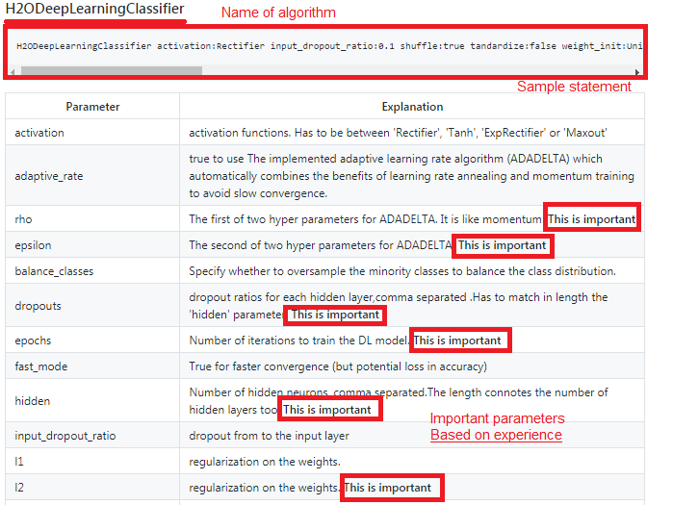
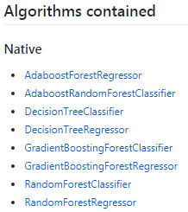
Finding good parameters vol 2
How to know which parameters to tune?
Find list of current available algorithms: https://github.com/kaz-Anova/StackNet#algorithms-contained
Click on the name or go to https://github.com/kaz-Anova/StackNet/blob/master/parameters/PARAMETERS.MD#[Your_estimators_name]
For example for deep learning try: https://github.com/kaz-Anova/StackNet/blob/master/parameters/PARAMETERS.MD#h2odeeplearningclassifier
There you can find a statement for StackNet as well as the most important parameters.

Slide 16
StackNet tips #1
Diversity based on algorithms:
2-3 gradient boosted trees
2-3 Neural nets
1-2 ExtraTrees/Random Forest
1-2 linear models as in logistic/ridge regression, linear svm
1 knn model
1 Factorization machine (libfm)
Diversity based on input data:
Categorical features: One hot, label encoding, target encoding, frequency
Numerical features: outliers, binning, derivatives, percentiles, scaling
Interactions : col1*/+-col2, groupby, unsupervised

Slide 17
StackNet tips #2
GBM_1
DL_1
FM_1
KNN_1
LIN_1
RF_1
model_x
model_z
model_y
……
GBM
Random Forest
DL
KNN
FM
Linear Regression
Tuning + Feature Engineering+
Feature Selection
Frequency
Target Encoding
Tuning + Feature Selection
DL
Random Forest
GBM
Linear Regression
FM
Tuning
KNN
Frequency
Frequency
Target Encoding
Onehot
Frequency
Binning
Onehot
Binning
Scaling
Onehot
Frequency
Target Encoding
Label encoding
Scaling
Binning
To ensure a model is diverse from another try setting a fixed parameter and then tune everything else

Slide 18
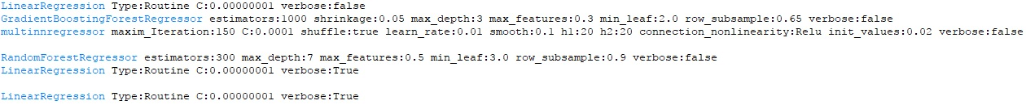
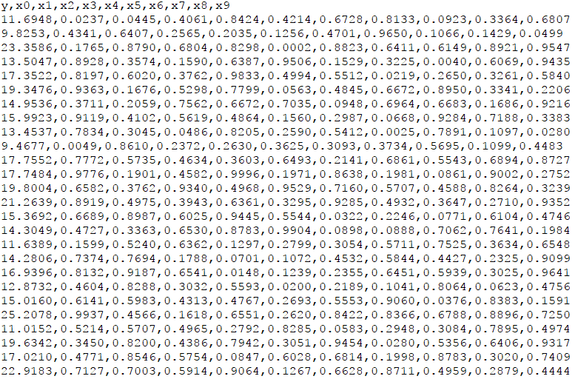
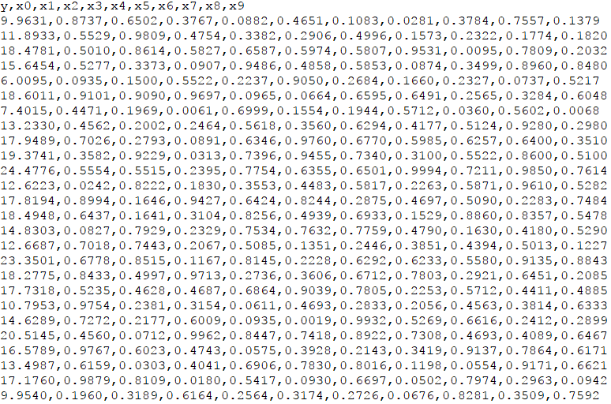
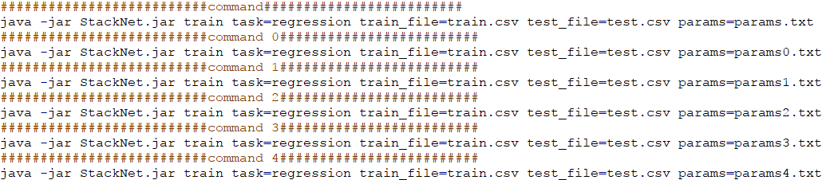
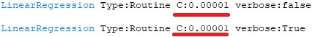
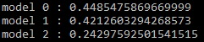
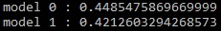
Java Example
params4.txt
params3.txt
params2.txt
Train.csv
params1.txt
Test.csv
Commands.txt
params.txt
params0.txt
java -jar StackNet.jar train task=regression train_file=train.csv test_file=test.csv params=params.txt pred_file=pred.csv test_target=true has_head=true verbose=true Threads=3 folds=4 metric=rmse
nn
LinearRegression
LinearRegression
RandomForest
LinearRegression
GBFR
LinearRegression

Slide 19
Python implementation - Algorithms
All Estimators that follow an sklearn api
Includes Regressors in classification and vice versa
Transformers are also credible inputs

Slide 20
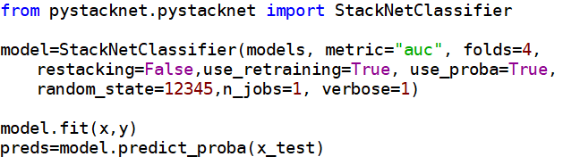
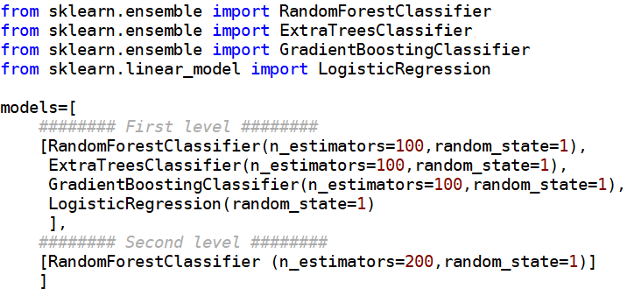
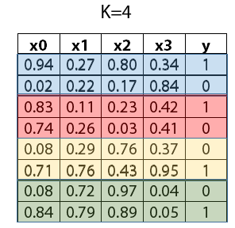
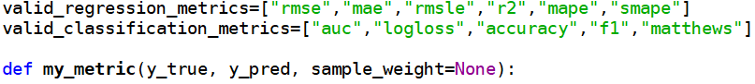
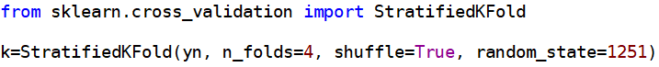
Python parameters

Slide 21

Useful Links and resources
Github java repository: https://github.com/kaz-Anova/StackNet .
Github python repository: https://github.com/h2oai/pystacknet
Facebook page : https://www.facebook.com/StackNet/ .
Search “StackNet examples” on google for various resources.
General blog about StackNet .
General information on Stacking with H2O .
Blog on StackNet winning a kaggle challenge .

Slide 22

Thank you
marios@h2o.ai
facebook.com/StackNet/
in/mariosmichailidis/
@StackNet_

